Slide 1

Azure OpenAI Service
Denise Schlesinger
Vlad Feigin

Slide 2
Agenda
Presentation - Introduction to LLMs, GPT and prompts
Lab #1 - Connect to OpenAI and ask questions
Presentation - Prompt engineering, Zero-shot learning, Few-shot learning
Lab #2 - Create prompts for summarization, Json, tabular answer
Presentation - Embeddings
Lab #3 - Create embeddings in pandas
Presentation - Langchain, Vector databases, agents, toolkits
Lab #4 - Search your company's files with OpenAI
Lab #5 - Ask your SQL DB questions in English
Bonus - Search your company's URLs with OpenAI

Slide 3
Introduction to LLMs, GPT and prompts

Slide 4
Lab #1

Slide 5
Prompt engineering Zero-shot learning Few-shot learning

Slide 6
Lab #2

Slide 7
Embeddings

Slide 8
Lab #3

Slide 9
Langchain Vector databases Agents Toolkits

Slide 10
Lab #4

Slide 11
Lab #5

Slide 12
Generative AI
Artificial Intelligence
1956
Artificial Intelligence
the field of computer science that seeks to create intelligent machines that can replicate or exceed human intelligence
Machine Learning
1997
Machine Learning
subset of AI that enables machines to learn from existing data and improve upon that data to make decisions or predictions
Deep Learning
2017
Deep Learning
a machine learning technique in which layers of neural networks are used to process data and make decisions
2021
Generative AI
Create new written, visual, and auditory content given prompts or existing data.
Notes:
Narrative/talk track:
What is a brief history of artificial intelligence?
Artificial intelligence (AI) has a long and storied history that spans many decades. Some of the earliest work in AI was done in the 1950s and 1960s, when researchers first began to explore the possibility of creating machines that could "think" like humans.
During the 1950s and 1960s, AI research focused primarily on "symbolic" AI, which involved creating symbolic representations of knowledge and using them to solve problems. Researchers in this field developed early versions of what are now known as expert systems, which are computer programs that mimic the decision-making abilities of human experts in a specific domain.
In the 1970s and 1980s, AI research began to shift away from symbolic AI and towards "sub-symbolic" AI, which involves using statistical methods and mathematical models to solve problems. This shift was driven in part by the realization that symbolic AI was too complex and difficult to scale, and in part by the development of new computer hardware that made it possible to process large amounts of data quickly.
In the 1990s and 2000s, AI research continued to evolve, and new subfields began to emerge. One of these was "machine learning," which focuses on creating algorithms that allow computers to learn from data without being explicitly programmed. Another was "neural networks," which are mathematical models inspired by the structure and function of the human brain.
Recently, Generative Models like GPT-3 and DALL-E, Variational Autoencoders, Generative Adversarial Networks and many more have risen and continue to advance the field of AI. These models are able to generate new examples that are similar to examples from a given dataset. It is being used in diverse fields such as natural language processing, computer vision, speech recognition and many more.
Overall, AI has come a long way since its inception in the 1950s, and it continues to evolve and improve at a rapid pace today.
What is Generative AI and where does it fit into the scope of AI?
Generative AI is a subfield of Artificial Intelligence that focuses on creating systems that can generate new examples, such as images, text, or speech, that are similar to examples from a given dataset. The goal of generative AI is to develop algorithms that can learn the underlying probability distribution of a given dataset and use this knowledge to generate new examples that are similar to the examples in the dataset.
Generative AI models can be classified into two broad categories: generative models and discriminative models. Generative models such as GPT-3, DALL-E, Variational Autoencoders etc learns the underlying probability distribution of the dataset and can generate new examples from the learned distribution. Discriminative models, such as deep neural networks, learn to differentiate between different classes or categories, and are generally used for tasks such as image or speech recognition.
Generative AI sits on top of other areas of AI like unsupervised learning, supervised learning and reinforcement learning. It relies on the capability of those models to extract useful features from the data and use that for learning the underlying probability distribution of the data which is used for generthe potential to be used in a wide range of applications, such as computer vision, natural language processing, speech recognition, and many more.
ating new examples.
Overall, generative AI is a rapidly growing field within AI, and it has

Slide 13










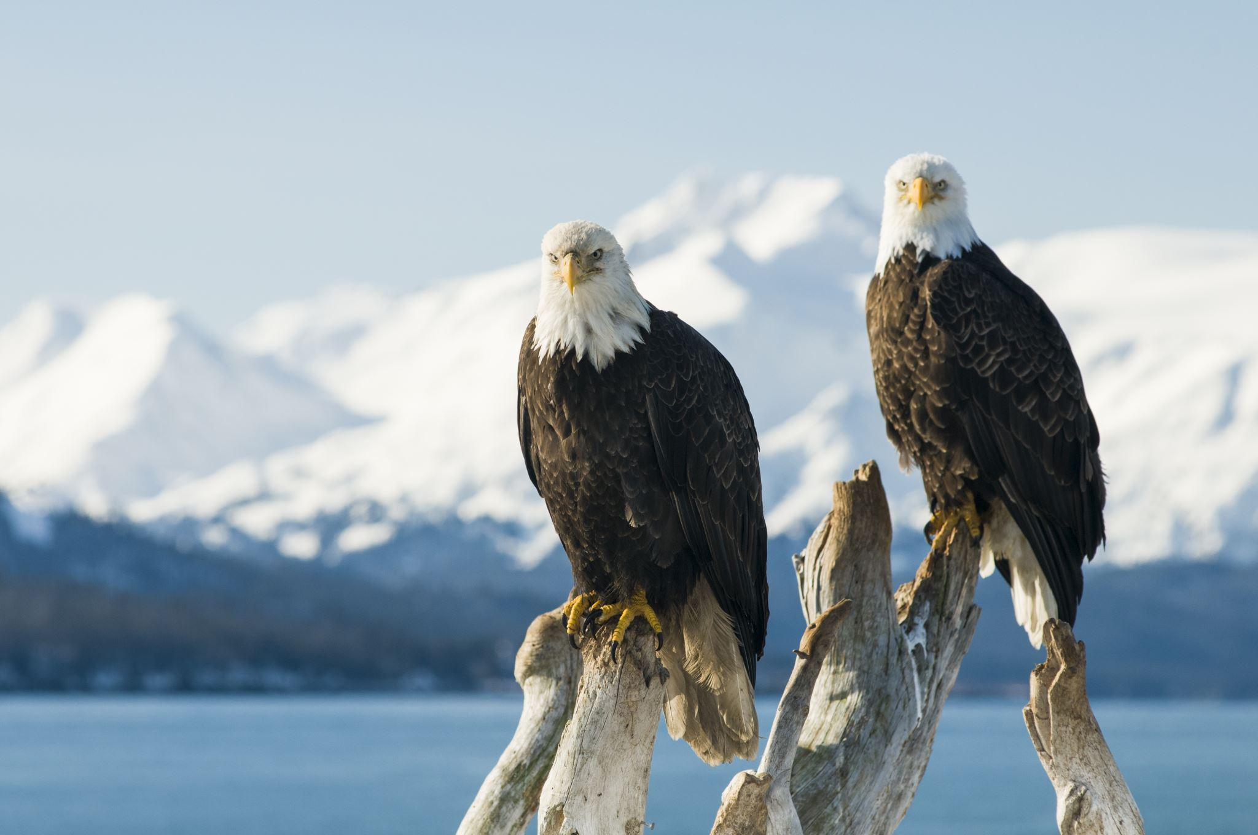

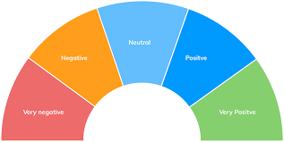
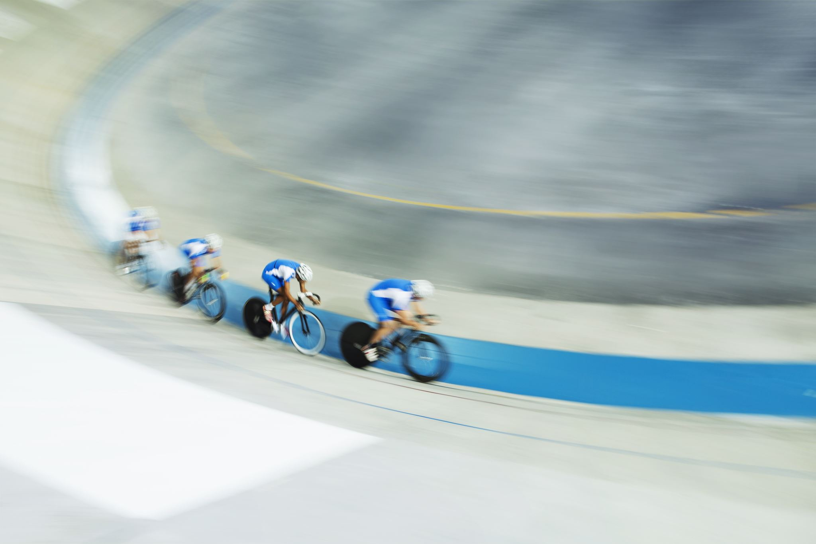
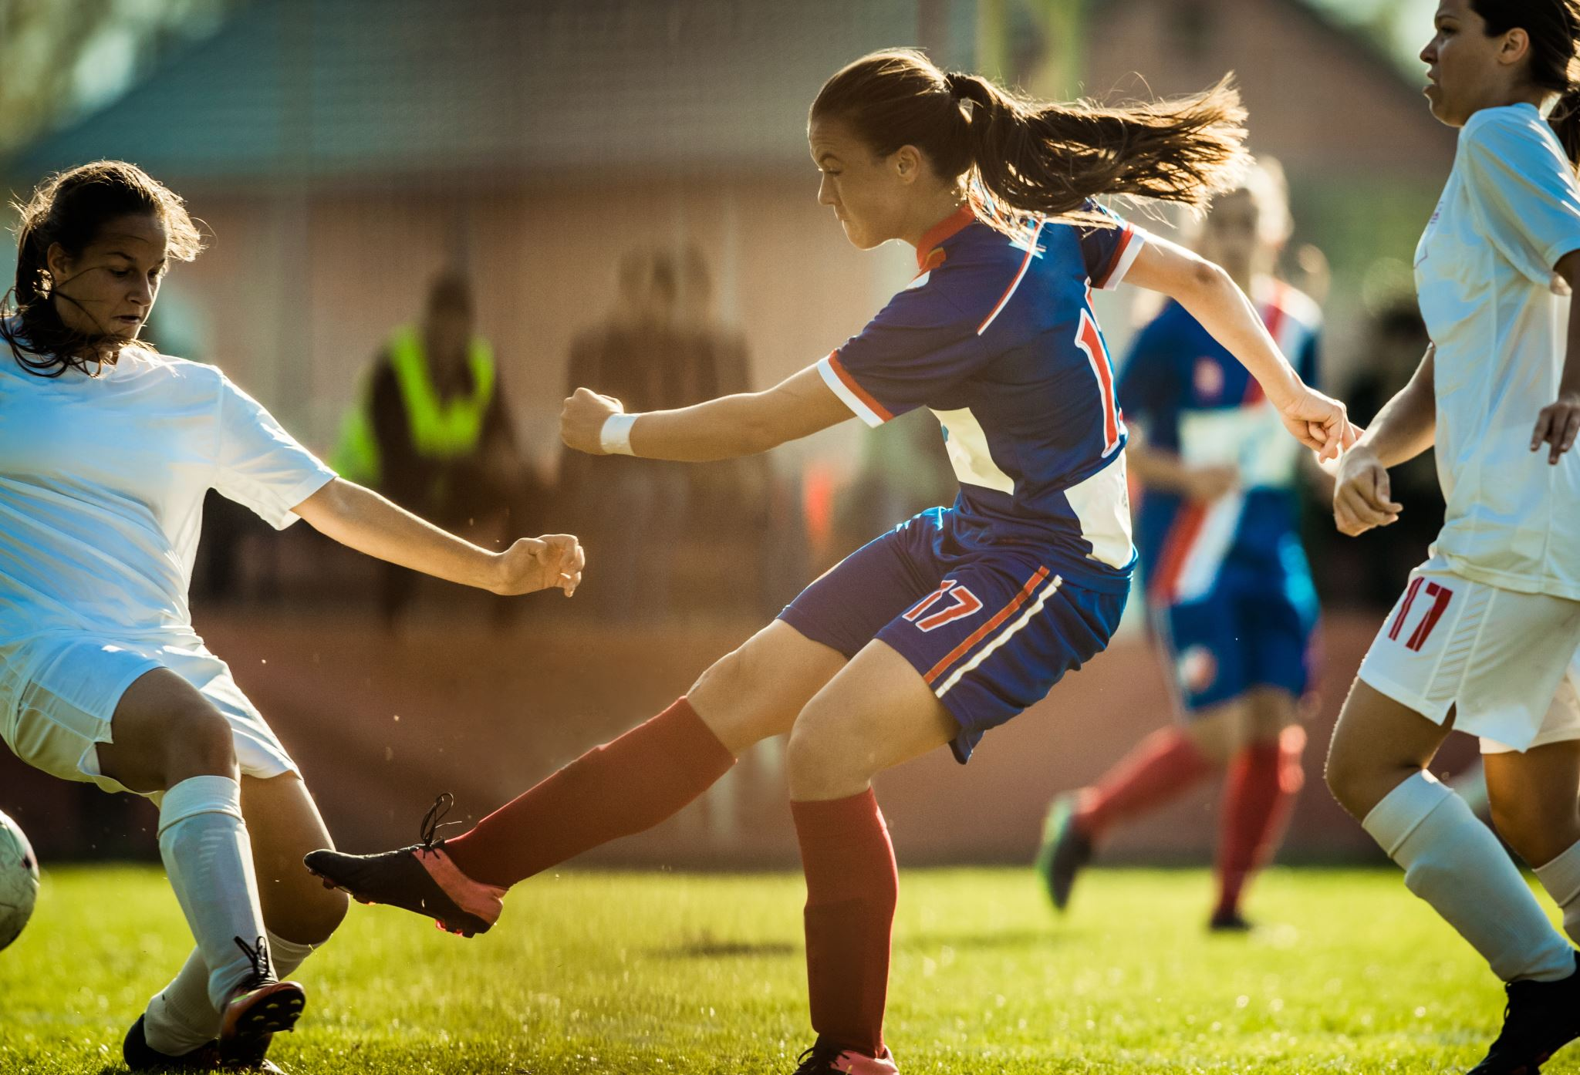
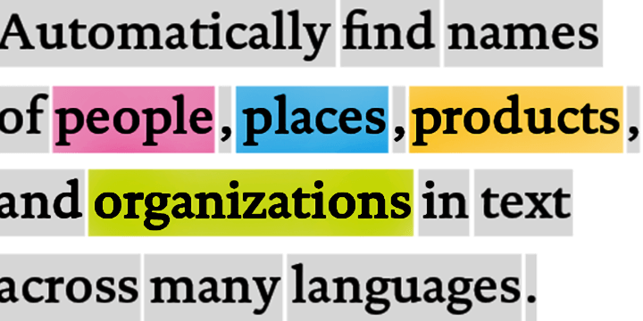
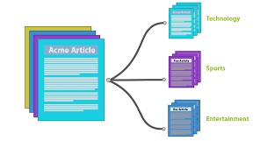








Traditional model development High cost and slow deployment—each service is trained disjointly
DEPLOYMENTS
Tagging Services
Spatial Analysis Services
Accessibility Services
Spatial Presenter
Azure Search, Video Indexer
EAGLE
EAGLE
FLOWER
PLAYING SOCCER
Classification
Object Detection
Object Tracking
Action Recognition
Entities
Topics
Sentiments
TASKS
Classification Model
Detection Model
Tracking Model
Action Model
Entity Recognition
Topic Classification
Sentiment Analysis
INDIVIDUAL MODEL (DISJOINTLY)
TRAINING DATA
(w/ ANNOTATION)
Tagging data
Detection data
Tracking data
Action data
Entity data
Topic data
Sentiment data
Notes:
(This and the next 9 slides help with the flow to move from the high-level to the deep dive)
The traditional approach of AI model development involves training a model on a very specific dataset with a specific task in-mind. For example, an entity recognition model requires specifically tagged entity data and a sentiment analysis model requires specifically trained sentiment data, which can be a bottleneck in training ML models. As a result, not only is a lot of tagged data required, but the data remains segmented for specific tasks, leading to higher development costs and slower deployments.

Slide 14





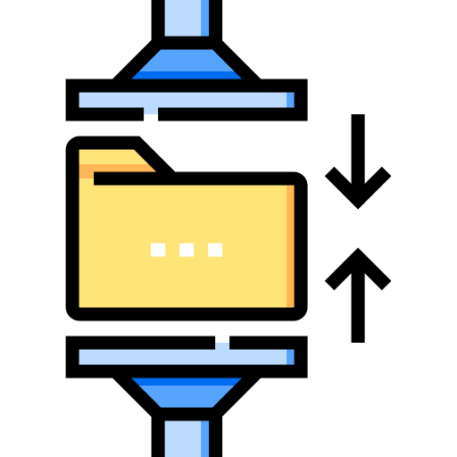



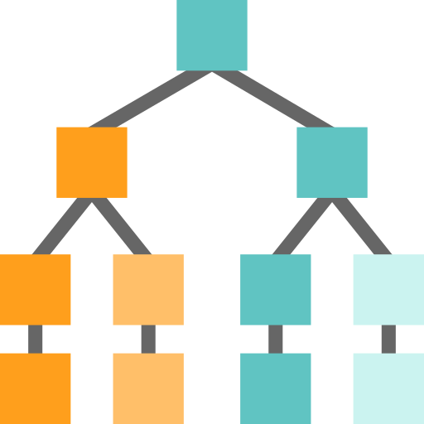




Foundation Models
Tasks
Question and Answering
Data
Sentiment Analysis
Text
Foundation Model
Information Extraction
Images
Speech
Training
Adaptation
Image Captioning
Structured Data
3d Signals
Transformer Model
Object Recognition
Instruction Follow
Notes:
The future of AI is models that are flexible, reusable and that can be applied to just about any domain or industry task.
Foundation models are at the heart of many of the latest breakthroughs. These models have been influential in the development of artificial intelligence systems, and have played a major role in changing how AI systems are constructed since their introduction in 2018.
A foundation model is a machine learning model that is trained on a large amount of unlabeled data, allowing it to be adapted to a wide variety of tasks. These models capture general patterns and structure of data, and aim to replace task-specific models by unifying different tasks and modalities into one, eliminating the need to train individual models and integrate several models together. An example is a large language foundation model that can perform various NLP tasks and can be used out-of-the-box due to its extensive training.
Foundation models use self-supervised learning and transfer learning to apply information learned in one situation to another situation or task.
Training these models can be complex and resource-intensive as they are typically large and require a significant amount of data. The scale of these models also plays a big role in the training process. So lets talk about that.

Slide 15




Generative AI
GPT-3
Codex
DALL·E
ChatGPT
Prompt:
Write a tagline for an ice cream shop.
Response:
We serve up smiles with every scoop!
Prompt:
Table customers, columns = [CustomerId, FirstName, LastName, Company, Address, City, State, Country, PostalCode]
Create a SQL query for all customers in Texas named Jane
query =
Response:
SELECT *
FROM customers
WHERE State = 'TX' AND FirstName = 'Jane'
Prompt: A white Siamese cat
Response:
What is the fastest animal on land?
the cheetah (Acinonyx jubatus), which can reach speeds of up to 60 miles (97 kilometers) per hour.
What makes them so fast?
Cheetahs are built for speed and have several adaptations that make them the fastest land animal: lean body, long legs, flexible spine, large nostrils and claws that don’t retract.
Notes:
GPT-3 is for text completion. A set of models that can understand and generate natural language.
Codex is a set of models that can understand and generate code, including translating natural language to code. It is a descendant of GPT-3 that’s been trained on both natural language and code.
DALL•E is a set of models that can generate or manipulate images from natural language.

Slide 16

Azure OpenAI Service
Deployed in your Azure subscription, secured by you, and tied to your datasets and applications
Large, pretrained AI models to unlock new scenarios
Custom AI models fine-tuned with your data and hyperparameters
GPT-3
Codex
Built-in responsible AI to detect and mitigate harmful use
DALL·E
ChatGPT
Enterprise-grade security with role-based access control (RBAC) and private networks

Slide 17
Azure OpenAI | Family of Models
GPT-3 models
Codex models
Davinci
Davinci-codex
Curie
Cushman-codex
Inferencing time
Babbage
Ada
Capability
Capability

Slide 18
Azure OpenAI | GPT-3 Family of Models
Model
Max # Tokens per Request
Description, performance, cost
Use cases
Davinci
Curie
Babbage
Ada
4,096 tokens
2048 tokens
2048 tokens
2048 tokens
Most capable GPT-3 model. Can do any task the other models can do, often with higher quality, longer output and better instruction-following.
Very capable, but faster and lower cost than Davinci.
Capable of straightforward tasks, very fast, and lower cost.
Capable of very simple tasks, usually the fastest model in the GPT-3 series, and lowest cost.
Complex intent, cause and effect, summarization for audience
Language translation, complex classification, text sentiment, summarization
Moderate classification, semantic search classification
Parsing text, simple classification, address correction, keywords
Notes:
While Davinci is generally the most capable, the other models can perform certain tasks extremely well with significant speed or cost advantages. For example, Curie can perform many of the same tasks as Davinci, but faster and for 1/10th the cost.
We recommend using Davinci while experimenting since it will yield the best results. Once you’ve got things working, we encourage trying the other models to see if you can get the same results with lower latency. You may also be able to improve the other models’ performance by fine-tuning them on a specific task.

Slide 19
Naming Convention Azure OpenAI's model names typically correspond to the following standard naming convention:
{family} - {capability} [-{input-type}] - {identifier}
Element | Description
{family} | The model family of the model. For example, GPT-3 models uses text, while Codex models use code.
{capability} | The relative capability of the model. For example, GPT-3 models include ada, babbage, curie, and davinci.
{input-type} | (Embeddings models only) The input type of the embedding supported by the model. For example, text search embedding models support doc and query.
{identifier} | The version identifier of the model.
text – davinci – 003
{family} - {capability}[ {identifier}
This model is a GPT-3 text model, the most powerful (davinci), and of the latest version (003)
*https://learn.microsoft.com/en-us/azure/cognitive-services/openai/concepts/models

Slide 20
Azure OpenAI | Comparing the GPT-3.5 models
Model
Description
text-davinci-002
text-davinci-003
ChatGPT model (gpt-3.5)
A GPT-3.5 model that was fine-tuned on natural language instructions and can perform a variety of tasks including summarization, question answering, classification, and more.
An improvement over the text-davinci-002 model. The model is similar to its predecessor but generally more capable across all tasks.
A model fine-tuned from text-davinci-002 that was optimized for working with dialogue. ChatGPT is a great model to use for conversational tasks and also excels at creative tasks.
Visit the Azure OpenAI Service pricing page for pricing details

Slide 21

Azure OpenAI | Overview of GPT-3
Generative pre-trained transformer 3 (GPT-3)
Autoregressive language model that uses deep learning to produce human-like text
Pre-trained on trillions of words
Predicts the most likely next word based on input text
General text-in/text-out interface

Slide 22
Azure OpenAI | GPT-3 Models
General purpose text-in/text-out interface—flexibility
Powerful language models accessible to all skill levels
Simple UX—validate proof of concepts fast
Built in ML science intuition for everyone, with deeper controls for ML practitioners

Slide 23
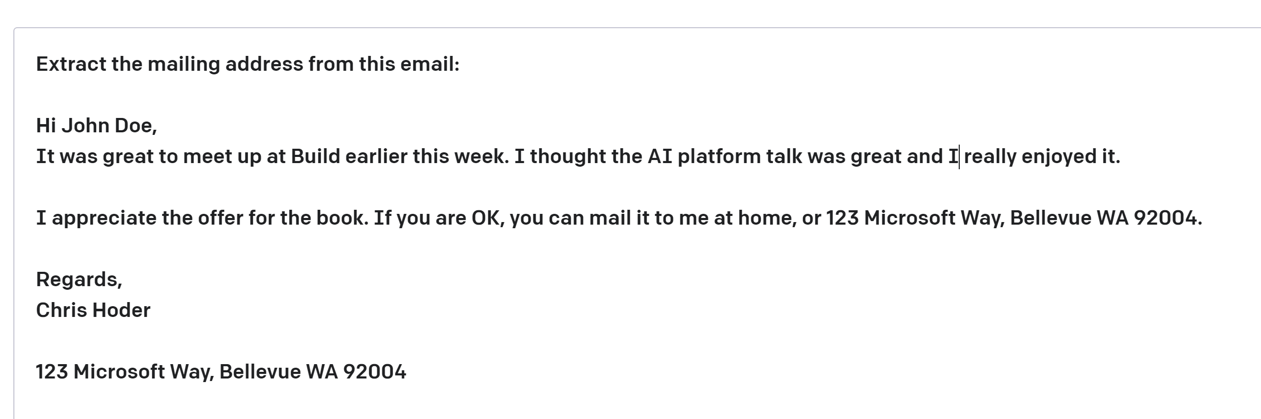
Azure OpenAI | GPT-3 Prompt Design
some context
Completion—Output that GPT-3 generates based on the prompt.
Prompt—Text input that provides some context to the engine on what is expecting.
Notes:
Prompt design (or prompt engineering)
There are three basic guidelines to creating prompts:
Show and tell. Make it clear what you want either through instructions, examples, or a combination of the two. If you want the model to rank a list of items in alphabetical order or to classify a paragraph by sentiment, show it that's what you want.
Provide quality data. If you're trying to build a classifier or get the model to follow a pattern, make sure that there are enough examples. Be sure to proofread your examples — the model is usually smart enough to see through basic spelling mistakes and give you a response, but it also might assume this is intentional and it can affect the response.
Check your settings. The temperature and top_p settings control how deterministic the model is in generating a response. If you're asking it for a response where there's only one right answer, then you'd want to set these lower. If you're looking for more diverse responses, then you might want to set them higher. The number one mistake people use with these settings is assuming that they're "cleverness" or "creativity" controls.

Slide 24
Azure OpenAI | GPT-3 Ideate, Experiment and Fine-Tune
Iterate on ideas with a general-purpose text-in/text-out interface
Refine with examples (‘few shot learning’) with
a simple UX
Optimize accuracy and latency to validate proof of concept fast
Prompt
Prompt
Prompt and completion examples
Summarize game commentary into highlights:
Shey Peddy is applying ball pressure at the top against Sabrina Ionescu. At 7:48 remaining in the quarter; Peddy
What are the main highlights of the game so far?
Turn game commentary into highlights:
Commentary: What a pickup she has
Main highlights: New York has domina
###
Commentary:
1. Turner is so important defensively to
2. Griner pulled way out, Hartley with
3. At 1:54 remaining in the quarter, Pho
Examples
"hyperparams": {
"batch_size": 4,
"learning_rate_multiplier": 0.1,
"n_epochs": 4,
"prompt_loss_weight": 0.1,
"use_packing": true
}
Fine-tuning
Inputs
Azure OpenAI Service
Sample response
Sample response
The game has been close with Phoenix leading New York 7-5. Shey Peddy has been key for Phoenix.
Main highlights: 1. New York has had a strong run in the 2. Phoenix leading by 1 point, 24-23 3. New York Liberty's comeback has be
Results

Slide 25
Tokens
You can think of tokens as pieces of words used for natural language processing. For English text, 1 token is approximately 4 characters or 0.75 words.
As a point of reference, the collected works of Shakespeare are about 900,000 words or 1.2M tokens.

Slide 26
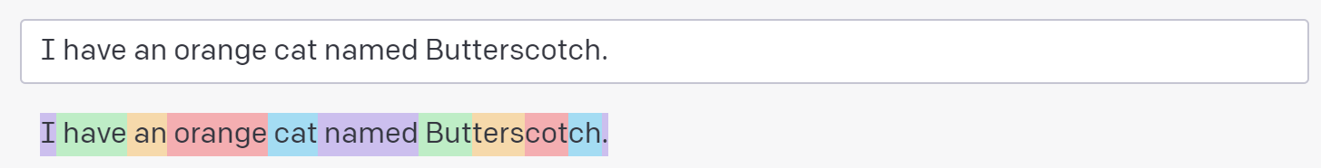
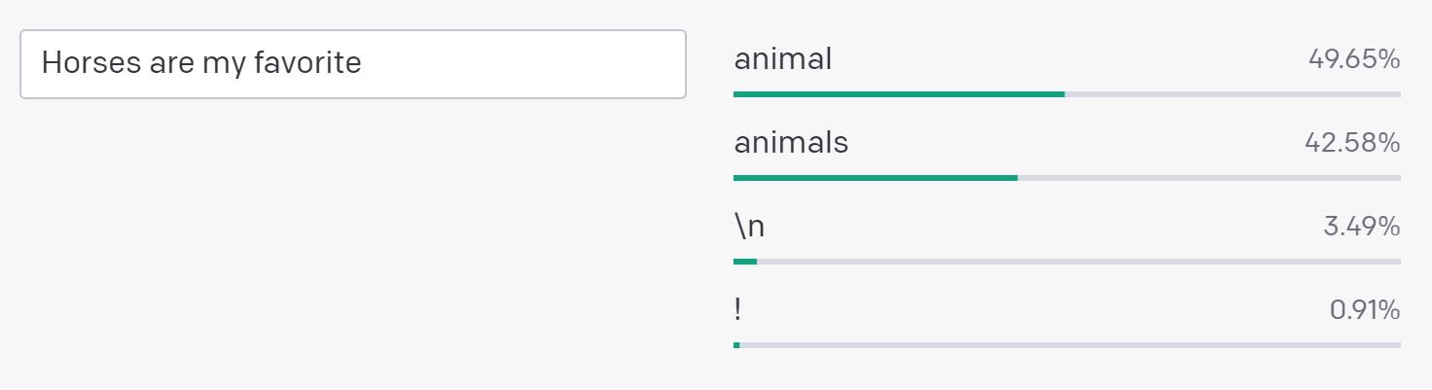
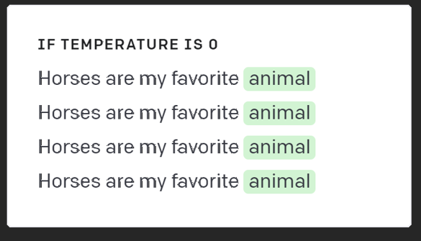
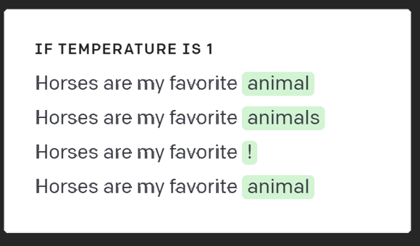
Understanding tokens and probabilities
Tokens:
Prompt Instruction
Suggest three names for an animal that is a superhero.
Animal: Cat
Names: Captain Sharpclaw, Agent Fluffball, The Incredible Feline
Animal: Dog
Names: Ruff the Protector, Wonder Canine, Sir Barks-a-Lot
Animal: Horse
Names:
Completion Temperature 0 (always the same)
Mighty Equine, The Great Galloper, Thunderhoof
Completion Temperature 1 (often different)
Probabilities:
Blaze the Miracle Mare, Pegasus the Winged Warrior, Secretariat the Superhorse
Completion Temperature 1 (often different)
Blaze of Glory, Sterling Silver, Thunderbolt

Slide 27



Model use out of the box—prompting
Entity Recognition
Entity Recognition
Prompt Instruction
Decoder
Extract the name of this person in this text.
Text: “My name is Simon, order status?”
Conversational AI
Application
NLU
Topic Classification
Sentiment Analysis
Completion
Agent:
How can I help you today?
Customer:
My name is Simon, order status?
Sentiment Analysis
Entity (Name): Simon
Sentiment: Positive
Prompt Instruction
Other NLU tasks
Decide whether a phrase’s sentiment is positive, neutral, or negative.
Phrase: “How can I help you today?”
Sentiment: Positive
NLP
Summarization
Summarization
Completion
Summary of conversation
Sentiment: Positive
Customer calling regarding an order.
Abstractive
Summarization
NLG
Paraphrase
Prompt Instruction
Summarize the following conversation:
Agent: How can I help you today?
Customer: My name is Simon, order status?
Foundation Model
Large Language Model
GPT-3
Sentence Generation
Other NLG tasks
Completion
Summary: Customer calling regarding an order.

Slide 28
Text classification Named Entity Recognition (Zero-Shot)
Prompt:
Extract the name and mailing address from this email:
Dear Kelly,
It was great to talk to you at the seminar. I thought Jane's talk was quite good.
Thank you for the book. Here's my address 2111 Ash Lane, Crestview CA 92002
Best,
Maya
Completion:
Name: Maya
Mailing Address: 2111 Ash Lane, Crestview CA 92002

Slide 29
Text classification Custom Named Entities (Few-Shot)
Prompt:
Extract job titles from the following sentences.
Sentence: John Doe has been working for Microsoft for 20 years as a Linux Engineer.
Job title: Linux Engineer
###
Sentence: John Doe has been working for Microsoft for 20 years and he loved it.
Job title: none
###
Sentence: Marc Simoncini | Director | Meetic
Job title: Director
###
Sentence: Damien is the CTO of Platform.sh, he was previously the CTO of Commerce Guys, a leading ecommerce provider.
Completion:
Job title: CTO

Slide 30
Text classification Multi-Label Text Classification (Few-Shot)
Prompt:
The following is a list of movies and the categories they fall into:
Topgun: As students at the United States Navy's elite fighter weapons school compete to be best in the class, one daring young pilot learns a few things from a civilian instructor that are not taught in the classroom.
Category: Drama, Action
Hustle: A basketball scout discovers a phenomenal street ball player while in Spain and sees the prospect as his opportunity to get back into the NBA.
Category: Comedy, Drama, Sport
The Northman: From visionary director Robert Eggers comes The Northman, an action-filled epic that follows a young Viking prince on his quest to avenge his father's murder.
Category:
Completion :
Action, Adventure, Drama

Slide 31
Text classification Paraphrasing (Few-Shot)
Prompt:
Article: Searching a specific search tree for a binary key can be programmed recursively or iteratively.
Paraphrase: Searching a specific search tree according to a binary key can be recursively or iteratively programmed.
Article: It was first released as a knapweed biocontrol in the 1980s in Oregon , and it is currently established in the Pacific Northwest.
Paraphrase: It was first released as Knopweed Biocontrol in Oregon in the 1980s , and is currently established in the Pacific Northwest.
Article: 4-OHT binds to ER , the ER / tamoxifen complex recruits other proteins known as co-repressors and then binds to DNA to modulate gene expression.
Paraphrase: The ER / Tamoxifen complex binds other proteins known as co-repressors and then binds to DNA to modulate gene expression
Article: Microsoft Corporation is a multinational technology company based in Redmond, Washington. It is best known for its Windows operating system, Microsoft Office suite, and Xbox video game consoles. The company was founded in 1975 by Bill Gates and Paul Allen and became dominant in the personal computer market with MS-DOS and Windows.
Completion:
Paraphrase: Microsoft Corporation is a technology company with a global presence, headquartered in Redmond, Washington. Its most recognizable products include the Windows operating system, Microsoft Office suite, and Xbox gaming consoles. The company was established in 1975 by Bill Gates and Paul Allen, and it achieved market dominance in personal computers with the MS-DOS and Windows operating systems.

Slide 32
Reason over unstructured text Question and answering
Prompt:
On Monday, Microsoft launched an OpenAI service as part of its Azure cloud platform, offering businesses and start-ups the ability to incorporate models like ChatGPT into their own systems. The company has already been building AI tools into many of its consumer products, such as a DALL-E 2 feature in its Bing search engine that can create images based on a text prompt, and the Information reported recently that it’s working to bring more of them to Microsoft Office as well.
What will Microsoft incorporate in its own systems?
Completion:
Microsoft plans to incorporate AI tools into its own systems, such as a DALL-E 2 feature in its Bing search engine that can create images based on a text prompt, and the Information reported recently that it’s working to bring more of them to Microsoft Office as well

Slide 33
Text classification Keyword Extraction (Few-Shot)
Prompt:
Information Retrieval (IR) is the process of obtaining resources relevant to the information need. For instance, a search query on a web search engine can be an information need. The search engine can return web pages that represent relevant resources.
Keywords: searching, missing, desert
###
I believe that using a document about a topic that the readers know quite a bit about helps you understand if the resulting keyphrases are of quality.
Keywords: document, understand, keyphrases
###
Since transformer models have a token limit, you might run into some errors when inputting large documents. In that case, you could consider splitting up your document into paragraphs and mean pooling (taking the average of) the resulting vectors.
Completion:
Keywords: transformer, models, token

Slide 34


Summarization Extractive vs Abstractive
Extractive
Extractive (Semantic)
Select parts of the original text to form a summary
Easier
Restrictive (no paraphrasing)
Peter and Elizabeth took a taxi to attend the night party in the city. While in the party, Elizabeth collapsed and was rushed to the hospital.
Peter and Elizabeth attend party city. Elizabeth rushed hospital
Generates new text using natural language generation techniques
More difficult
More flexible (more human)
Peter and Elizabeth took a taxi to attend the night party in the city. While in the party, Elizabeth collapsed and was rushed to the hospital.
Elizabeth was hospitalized after attending a party with Peter.

Slide 35
Abstractive summarization Contact Center Summarization
Prompt:
Summarize this for a call center agent:
Agent: Thank you for calling ADM. Who am I am speaking to?
Customer: Hello, my name is Peter Smith. I own a small business and have some questions regarding payroll processing.
Agent: Good morning, Peter, before we get started may I ask you a few questions so that I better answer your questions today?
Customer: Thank you that is quite helpful. Are there specific regulations that I need to follow?
Agent: Certain aspects of payroll processing are regulated by the Internal Revenue Service (IRS) and the Department of Labor (DOL)
Completion:
The agent is speaking to a customer named Peter Smith. Peter is asking for tips on manual payroll processing. The agent also informs Peter that certain aspects of payroll processing are regulated by the Internal Revenue Service (IRS) and the Department of Labor (DOL).

Slide 36
Prompt Insert Only DaVinci-002+
Before
After
These are agenda topics for a customer presentation.
1. Introduction to GPT3
[insert]
10. Conclusion
These are agenda topics for a customer presentation.
Introduction to GPT3
Overview of GPT3 Features
Benefits of GPT3
GPT3 Use Cases
GPT3 Pricing
GPT3 Security
GPT3 Support
GPT3 Integration
Q&A Session
10. Conclusion

Slide 37
Intent classification (Few-Shot)
listen to WestBam album allergic on google music: PlayMusic
give me a list of movie times for films in the area: SearchScreeningEvent
show me the picture creatures of light and darkness: SearchCreativeWork
I would like to go to the popular bistro in oh: BookRestaurant
what is the weather like in the city of Frewen in the country of Venezuela: GetWeather
I want to book a flight to Delhi: bookFlight

Slide 38
Chatbot with personality (Few-Shot)
This is a discussion between a [human] and a [robot].
The [robot] is very nice and empathetic.
[human]: Hello nice to meet you.
[robot]: Nice to meet you too.
###
[human]: How is it going today?
[robot]: Not so bad, thank you! How about you?
###
[human]: I am ok, but I am a bit sad...
[robot]: Oh? Why that?
###
[human]: I broke up with my girlfriend...
[robot]: Oh? How did that happen?

Slide 39
Analyze customer feedback (Few-Shot)
Customer review:
The red mountain bike I recently purchased is an excellent choice for anyone who wants a reliable, high-quality bike for off-road adventures. The bike is built with sturdy materials and the red color gives it a bold and stylish look. The bike also has many great features that make it a joy to ride. One of my favorite things about this bike is how customizable it is. The seat can be easily adjusted to fit different heights, and the handlebars can be adjusted for a comfortable riding position. The bike also has multiple gears, allowing you to adjust the resistance and speed as needed.
Analyze the customer review and provide feedback and sentiment
Feedback:
Overall, the customer feedback is positive and indicates satisfaction with the red mountain bike purchased. The customer highlights the bike's reliability and high-quality construction, as well as its stylish appearance. The customer also praises the bike's many features that make it enjoyable to ride, including its customization options and multiple gears.

Slide 40
Topic classification for Bot routing (Few-Shot)
Message: When the spaceship landed on Mars, the whole humanity was excited
Topic: space
###
Message: I love playing tennis and golf. I'm practicing twice a week.
Topic: sport
###
Message: Managing a team of sales people is a tough but rewarding job.
Topic: business
###
Message: I am trying to cook chicken with tomatoes
Topic: Cooking

Slide 41
Summarize conversational transcripts (Few-Shot)
Summarize this conversation transcript:
Agent: Thank you for calling ADM. Who am I am speaking to? Customer: Hello, my name is Peter Smith. I own a small business and have some questions regarding payroll processing. Agent: Good morning, Peter, before we get started may I ask you a few questions so that I better answer your questions today? Customer: Yes, of course. Agent: In case we get disconnected, can you please share your phone number and email address so that we may contact and share additional information? Customer: Yes, my phone number is (514) 777-5232 and my email address is petersmith@gmail.com Agent: May I ask where is your business located so I can answer your questions based on your location Customer: Yes, my business is located in Miami, Florida. Agent: Thank you, what can I help you with today? Customer: I am fairly new to payroll processing and do everything manually today. Do you have any advice or tips on manual payroll processing? Agent: If you’re a small business with only a few employees and choose to process payroll manually, you will need to keep precise records of hours worked, wages paid and worker classifications, among other details. You must also ensure your calculations are correct and remember to file all the necessary taxes and paperwork with government authorities on time. Customer: Thank you that is quite helpful. Are there specific regulations that I need to follow? Agent: Certain aspects of payroll processing are regulated by the Internal Revenue Service (IRS) and the Department of Labor (DOL). Some of the laws you must comply with include: Fair Labor Standards Act (FLSA), Federal Insurance Contributions Act (FICA), Federal Unemployment Tax Act (FUTA) Customer: This sounds very complicated. I don’t really feel like managing all of this. Agent: If you would like I can transfer you to one of our specialized agents who can talk to you about payroll service providers that would help you manage all of that. Customer: That would be great, thank you very much for al your help.
The agent is speaking to a customer named Peter Smith. Peter is asking for tips on manual payroll processing. The agent advises Peter to keep precise records and to file all necessary taxes and paperwork on time. The agent also informs Peter that certain aspects of payroll processing are regulated by the Internal Revenue Service (IRS) and the Department of Labor (DOL). Finally, the agent offers to transfer Peter to a specialized agent who can help him find a payroll service provider.

Slide 42
Product description and ad generation (Few-Shot)
Generate a product description out of keywords.
Keywords: shoes, women, $59
Sentence: Beautiful shoes for women at the price of $59.
###
Keywords: trousers, men, $69
Sentence: Modern trousers for men, for $69 only.
###
Keywords: gloves, winter, $19
Sentence: Amazingly hot gloves for cold winters, at $19.
###
Keywords: t-shirt, men, $39
Sentence:
Sentence: Extraordinary t-shirt for men, for $39 only.

Slide 43
Product recommendation (Few-Shot)
Generate product recommendations:
Product: table, chair, plate
Recommendation: utensils
###
Product: skis, skateboard, bike
Recommendation: golf clubs
###
Product: shoes, shirt, hat
Recommendation: Pants

Slide 44
Prompt Engineering Guide
1. Give clearer instructions
2. Split complex tasks into simpler subtasks
3. Structure the instruction to keep the model on task
4. Prompt the model to explain before answering
5. Ask for justifications of many possible answers, and then synthesize
6. Generate many outputs, and then use the model to pick the best one
7. Fine-tune custom models to maximize performance
Notes:
Now, When GPT-3 fails on a task, what should you do?
Search for a better prompt that elicits more reliable answers?
Invest in thousands of examples to fine-tune a custom model?
Assume the model is incapable of the task, and move on?
There is no simple answer - Getting the model to reason and provide the desired response is an art in itself, yes you can use one-shot and few-shot learning but in many cases this wont be enough.
MY guess is that, a lot of the work we are going to do as experts is to master this art and come up with techniques to help our customers use these models to derive the outcome desired before going into expensive fine-tuning solutions. The following is a guide to some of these techniques. The beauty of these models is that we don’t have to tinker with code , we can simply use prompt engineering / natural language to guide the model to reason through a human partnership approach.

Slide 45
Prompt Chaining
Entity Extraction
Summarization
Sentiment Analysis
Please extract entities from the following news article: 'The new iPhone model is set to be released next month. It has been highly anticipated by Apple fans and is expected to feature a larger screen and improved camera
{'text': 'iPhone', 'type’: 'PRODUCT'}, {'text': 'Apple’, 'type': 'ORGANIZATION'}]
Please summarize the information about the product
[{'text': 'iPhone', 'type': 'PRODUCT'}, {'text': 'Apple', 'type': 'ORGANIZATION’}]
The iPhone is a line of smartphones designed and marketed by Apple Inc. These devices combine a computer, camera, and internet connectivity in a single device, and are known for their sleek design and user-friendly interface.
Please provide a sentiment for the following text:
The iPhone is a line of smartphones designed and marketed by Apple Inc. These devices combine a computer, camera, and internet connectivity in a single device, and are known for their sleek design and user-friendly interface.
Positive

Slide 46


Prompt Chunking (token limit)
Then all summaries are passed to GPT again to summarize, i.e. second round of summarization. The sum of the summaries has to fit within the token limit.
Please summarize and extract topic: Global warming refers to the gradual increase in the overall temperature of the Earth's atmosphere, primarily caused by the burning of fossil fuels such as coal, oil, and natural gas. This burning releases carbon dioxide and other greenhouse gases into the atmosphere, which trap heat and cause the Earth's temperature to rise.
Climate change is a pressing issue that needs to be addressed immediately. Governments around the world need to take immediate action to reduce carbon emissions and invest in renewable energy sources. Failure to do so will have dire consequences for future generations
Please summarize the following text: 'Climate change is a pressing issue that needs to be addressed immediately. The increasing levels of carbon dioxide in the atmosphere are causing the Earth's temperature to rise, which is leading to more frequent and severe natural disasters. Governments around the world need to take immediate action to reduce carbon emissions and invest in renewable energy sources. Failure to do so will have dire consequences for future generations'"
Large Text
Beyond Token Limit
Chunks
The text is discussing global warming, which is the gradual increase in the overall temperature of the Earth's atmosphere caused by the burning of fossil fuels. This burning releases greenhouse gases, such as carbon dioxide, into the atmosphere which trap heat and cause the temperature to rise. The text also highlights the urgency of the issue of climate change and the need for governments to take action to reduce carbon emissions and invest in renewable energy sources. Failure to address this issue will have negative consequences for future generations.
Topic: Climate change and Global warming.
Climate change is a pressing issue that needs to be addressed immediately. Governments around the world need to take immediate action to reduce carbon emissions and invest in renewable energy sources. Failure to do so will have dire consequences for future generations
Continue to next prompt

Slide 47

Few-Shot Reasoning (Human version)
1st prompt
2nd prompt—provide reasoning
Roger has 5 tennis balls. He buys 2 more cans of tennis balls. Each can has 3 tennis balls. How many tennis balls does he have now?
Answer: The answer is 11.
The cafeteria has 23 apples. If they used 20 to make lunch and bought 6 more, how many do they have?
The answer is 27
Roger has 5 tennis balls. He buys 2 more cans of tennis balls. Each can has 3 tennis balls. How many tennis balls does he have now?
Answer: Roger started with 5 balls. 2 cans of 3 tennis balls each is 6 tennis balls. 5+6 = 11. The answer is 11.
The cafeteria has 23 apples. If they used 20 to make lunch and bought 6 more, how many do they have?
The cafeteria had 23 apples originally. They used 20 to make lunch. So they had 23-20 = 3. They bought 6 more apples, so they have 3 + 6 = 9. The answer is 9.
Notes:
As an example, You may have heard that these models are not very good at doing math or artithmetic or deriving logic. But like humans,
If you were asked to multiply 13 by 17, would the answer pop immediately into your head? For most of us, probably not. Yet, that doesn't mean humans are incapable of two-digit multiplication. With a few seconds, and some pen and paper, it's not too taxing to work out that 13 x 17 = 221. The model needs to be guided in the same way.
Similarly, if you give GPT-3 a task that's too complex to do in the time it takes to calculate its next token, it may confabulate an incorrect guess. Yet, akin to humans, that doesn't necessarily mean the model is incapable of the task. With some time and space to reason things out, the model still may be able to answer reliably.
One example , as you see here is to use few shot learning to drive the model on how it should reason. In other words, you are explicitly telling the mode how to think by prompting how it should reason for a similar problem.

Slide 48
Model Reasoning—Chain-of-Thought
Before
After
What is the annual water demand of a single-family household containing four people who are at home an average of 200 days per year and use an average of 100 liters of water per day?
The annual water demand of a single-family household containing four people who are at home an average of 200 days per year and use an average of 100 liters of water per day is 8,000,000 liters per year.
What is the annual water demand of a single-family household containing four people who are at home an average of 200 days per year and use an average of 100 liters of water per day?
Let’s think step by step and explain the calculation step by step.
Step 1: Calculate the total number of days in a year: There are 365 days in a year.
Step 2: Calculate the total number of days the family is at home: The family is at home an average of 200 days per year.
Step 3: Calculate the total water demand of the family: The family uses an average of 100 liters of water per day. Therefore, the total water demand of the family is 100 liters x 200 days = 20,000 liters per year.
Step 4: Calculate the annual water demand of the single-family household: The annual water demand of the single-family household is 20,000 liters per year.
Notes:
Another powerful technique for improving the reliability of answers is to prompt the model to gradually reason out the answer rather than jumping immediately to the final answer. By 'thinking aloud' the model can be far more likely to arrive at the correct answer.
This technique called Chain-of-Thought, actually only discovered recently , is a super powerful technique, not only can it be used to provide model explainibiilty (where sometimes GPT-3 is seen as a blackbox) but it can help the model reason and arrive at a desired output by simply just telling the model to think step by step.

Slide 49
Using Chain-of-Thought for Reasoning
1st prompt—Reason Extraction
2nd prompt—Answer Extraction
On average Joe throws 25 punches per minute. A fight lasts 5 rounds of 3 minutes. How many punches did he throw?
Let’s think step by step and explain the calculation step by step.
In one minute, Joe throws 25 punches.
In three minutes, Joe throws 3 * 25 = 75 punches.
In five rounds, Joe throws 5*75 = 375 punches.
One average Joe throws 25 punches per minute. A fight lasts 5 rounds of 3 minutes. How many punches did he throw?
In one minute, Joe throws 25 punches.
In three minutes, Joe throws 3 * 25 = 75 punches.
In five rounds, Joe throws 5*75 = 375 punches.
Therefore, the answer (Arabic numerals) is
The cafeteria had 23 apples originally. They used 20 to make lunch. So they had 23-20 = 3. They bought 6 more apples, so they have 3 + 6 = 9. The answer is 9.
Notes:
You can also combine both chain-of-thought and prompt-chaining so that the model can derive the answer that you want. So in this example, you are using chain-of-thought to extract the reasoning behind the problem and using prompt-chaining to provide the same reasoning to a similar problem.
Chain-of-Thought can help enormously at doing math or artithmetic or deriving logic. In fact, the author of this technique benchmarked this approach and the results were astonishing. It quadrupled accuracy, from 18% to 79%.
The authors found that it was most helpful for multi-step arithmetic problems, symbolic reasoning problems, strategy problems, and other reasoning problems

Slide 50
Few-Shot—Chain-of-Thought—Examples
Math Word Problems (free response)
Q: Roger has 5 tennis balls. He buys 2 more cans of tennis balls. Each can has 3 tennis balls. How many tennis balls does he have now?
A: Roger started with 5 balls. 2 cans of 3 tennis balls each is 6 tennis balls. 5 + 6 = 11.
The answer is 11.
Math Word Problems (multiple choice)
Q: How many keystrokes are needed to type the numbers from 1 to 500? Answer Choices: (a) 1156 (b) 1392 (c) 1480 (d) 1562 (e) 1788
A: There are 9 one-digit numbers from 1 to 9. There are 90 two-digit numbers from 10 to 99. There are 401 three-digit numbers from 100 to 500. 9 +90(2) + 401(3) = 1392.
The answer is (b).
CSQA (commonsense)
Q: Sammy wanted to go to where the people were. Where might he go? Options: (a) race track (b) populated areas (c) desert (d) apartment (e) roadblock
A: The answer must be a place with a lot of people. Race tracks, desert, apartments, and roadblocks don't have a lot of people, but populated areas do.
So the answer is (b).
StrategyQA
Q: Yes or no: Would a pear sink in water?
A: The density of a pear is about 0.6 g/cm^3, which is less than water. Thus, a pear would float
So the answer is no.
Sports Understanding
Q: Is the following sentence plausible? "Joao Moutinho caught the screen pass in the NFC championship.“
A: Joao Moutinho is a soccer player. The NFC championship is part of American football, not soccer.
So the answer is no.
Date Understanding
Q: The concert was scheduled to be on 06/01/1943, but was delayed by one day to today. What is the date 10 days ago in MM/DD/YYYY?
A: One day after 06/01/1943 is 06/02/1943, so today is 06/02/1943. 10 days before today is 05/23/1943.
So the answer is 05/23/1943.
SayCan (Instructing a robot)
Human: How would you bring me something that isn’t a fruit?
Explanation: the user wants something to eat that isn't a fruit. An energy bar is not a fruit, so I will bring the user an energy bar.
Plan: 1. find(energy bar) 2. pick(energy bar) 3. find(user) 4. put(energy bar) 5. done().
Coin Flip (state tracking)
Q: A coin is heads up. Maybelle flips the coin. Shalonda does not flip the coin. Is the coin still heads up?
A: The coin was flipped by Maybelle. So the coin was flipped 1 time, which is an odd number. The coin started heads up, so after an odd number of flips, it will be tails up.
So the answer is no.
Last Letter Concatenation
Q: Take the last letters of the words in "Lady Gaga" and concatenate them.
A: The last letter of "Lady" is "y". The last letter of "Gaga" is "a". Concatenating them is "ya".
So the answer is ya
Notes:
For your reference, Here are some other examples of for a range of arithmetic, common- sense, and symbolic reasoning Chains of thought that you can use in your prompts. Highlites are the actual derived chain-of-prompt.

Slide 51
Selection-inference prompting
It takes Amy 4 minutes to climb to the top of a slide. It takes her 1 minute to slide down. The water slides close in 15 minutes. How many times can she slide before it closes? 14 times
It takes Amy 4 minutes to climb to the top of a slide. It takes her 1 minute to slide down. The water slides close in 15 minutes. How many times can she slide before it closes?
To solve "How many times can she slide before it closes" we need to first solve: Chain-of-Thought
How much time does it take for Amy to climb and slide?
Decomposes problem into a smaller task (Reasoning)
It takes Amy 4 minutes to climb to the top of a slide. It takes her 1 minute to slide down. The water slides close in 15 minutes. How many times can she slide before it closes?
How much time does it take for Amy to climb and slide?
It takes Amy 5 minutes to climb and slide
It takes Amy 4 minutes to climb to the top of a slide. It takes her 1 minute to slide down. The water slides close in 15 minutes. How many times can she slide before it closes?
It takes Amy 5 minutes to climb and slide.
She can slide 3 times before the water slides close.
Add new fact to context
Notes:
But Sometime chain-of-thought also leads to wrong results, it especially struggles when the examples are short but the task is long. and sometimes you as a human do not know how to solve the problem yourself.
One interesting trick is to have the model decompose the task into smaller tasks and figure it out on it’s own. This allows the model to reason along the way and can lead to much better results. The technique is called selection-inference prompting,

Slide 52

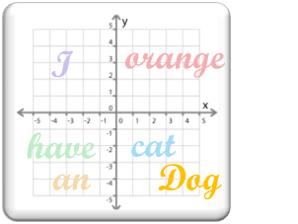

Model Adaptation with specific domain data
Fine-Tuning
GPT-3
Domain Data
Small Set of Labeled Data
Fine-tuning results is a new model being generated with updated weights and biases.
This is in contrast to few-shot learning in which model weights and biases are not updated.
minimum of several thousand examples
Maximum of 2.5M tokens or 80-100mb size
high-dimensional vector space
(Embeddings)
Fine-tuning
Model parameters adjusted (Weights and Bias)
Gradient Update
Fine-Tuned GPT-3 Model
Perform any domain-specific NLP tasks

Slide 53
When Fine-Tuning is needed
If model is making untrue statements (“hallucinations”), then mitigate the hallucinations
Accuracy of results of the model does not meet customer requirements
Fine-tuning lets you get more out of the models available through the API by providing:
Higher quality results than prompt design
Ability to train on more examples than can fit in a prompt
Lower latency requests
Fine-tuning improves over few-shot learning by training on many more examples than can fit in the prompt, letting you achieve better results on a wide number of tasks.

Slide 54

Best practices of Fine-Tuning
Fine-tuning data set must be in JSON format
A set of training examples that each consist of a single input ("prompt") and its associated output ("completion")
For classification task, the prompt is the problem statement, completion is the target class
For text generation task, the prompt is the instruction/question/request, and completion is the text ground truth

Slide 55
Best practices of Fine-Tuning
Fine-tuning data size: Advanced model (Davinci) performs better with limited amount of data; with enough data, all models do well.
Fine-tuning performs better with more high-quality examples.
To fine-tune a model that performs better than using a high-quality prompt with base models, you should provide at least a few hundred high-quality examples, ideally vetted by human experts.
From there, performance tends to linearly increase with every doubling of the number of examples. Increasing the number of examples is usually the best and most reliable way of improving accuracy.

Slide 56
Best practices of Fine-Tuning
Make sure to completely remove wrong labels in fine-tuning dataset. If you are fine-tuning on a pre-existing dataset rather than writing prompts from scratch, be sure to manually review your data for offensive or inaccurate content if possible, or review as many random samples of the dataset as possible if it is large.

Slide 57
Fine-Tuning data formatting
To fine-tune a model, you'll need a set of training examples that each consist of a single input ("prompt") and its associated output ("completion").
This is notably different from using the base models, where you might input detailed instructions or multiple examples in a single prompt.
Each prompt should end with a fixed separator to inform the model when
the prompt ends and the completion begins.
A simple separator which generally works well is \n\n###\n\n.
The separator should not appear elsewhere in any prompt.
Notes:
To fine-tune a model, you'll need a set of training examples that each consist of a single input ("prompt") and its associated output ("completion"). This is notably different from using the base models, where you might input detailed instructions or multiple examples in a single prompt.
Each prompt should end with a fixed separator to inform the model when the prompt ends and the completion begins. A simple separator which generally works well is \n\n###\n\n. The separator should not appear elsewhere in any prompt.
Each completion should start with a whitespace due to tokenization, which tokenizes most words with a preceding whitespace.
Each completion should end with a fixed stop sequence to inform the model when the completion ends. A stop sequence could be \n, ###, or any other token that does not appear in any completion.
For inference, you should format your prompts in the same way as you did when creating the training dataset, including the same separator. Also specify the same stop sequence to properly truncate the completion.

Slide 58
Fine-Tuning Data Formatting
Each completion should start with a whitespace due to tokenization, which tokenizes most words with a preceding whitespace.
Each completion should end with a fixed stop sequence to inform the model when the completion ends.
A stop sequence could be \n, ###, or any other token that does not appear in any completion.
For inference, you should format your prompts in the same way as you did when creating the training dataset, including the same separator.
Also specify the same stop sequence to properly truncate the completion.

Slide 59
Hyperparameters specific to Fine-Tuning
Parameter | Description | Recommendation
n_epochs controls how many times each example is trained on | The number of epochs to train the model for. An epoch refers to one full cycle through the training dataset. | Start from 4 and small datasets may need more epochs and large datasets may need fewer epochs. If you see low training accuracy (underfitting), try increasing n_epochs. If you see high training accuracy but low validation accuracy (overfitting), try lowering n_epochs.
batch_size controls the number of training examples used in a single training pass | The batch size to use for training. The batch size is the number of training examples used to train a single forward and backward pass. | We’ve seen good performance in the range of 0.01% to 4% of training set size. In general, we've found that larger batch sizes tend to work better for larger datasets.
learning_rate_multiplier controls rate at which the model weights are updated | The learning rate multiplier to use for training. The fine-tuning learning rate is the original learning rate used for pre-training, multiplied by this value. | We recommend experimenting with values in the range 0.02 to 0.2 to see what produces the best results. Empirically, we've found that larger learning rates often perform better with larger batch sizes. Empirically, we found learning_rate_multiplier has minor impact compared to n_epochs and batch_size.
prompt_loss_weight controls how much the model learns from prompt tokens vs completion tokens | The weight to use for loss on the prompt tokens. This value controls how much the model tries to learn to generate the prompt (as compared to the completion, which always has a weight of 1.0.) Increasing this value can add a stabilizing effect to training when completions are short. | When a model is fine-tuned, it learns to produce text it sees in both the prompt and the completion. In fact, from the point of view of the model being fine-tuned, the distinction between prompt and completion is mostly arbitrary. The only difference between prompt text and completion text is that the model learns less from each prompt token than it does from each completion token. This ratio is controlled by the prompt_loss_weight, which by default is 0.1. If prompts are extremely long (relative to completions), it may make sense to reduce this weight to avoid over-prioritizing learning the prompt. Empirically, we found prompt_loss_weight has minor impact compared to n_epochs and batch_size.

Slide 60
Guides and examples for Fine-Tuning
Getting started with Fine-Tuning:
How to customize a model with Azure OpenAI - Azure OpenAI | Microsoft Learn
Fine-tuning—OpenAI API
https://platform.openai.com/docs/guides/fine-tuning/general-best-practices
Detailed examples of fine-tuning
[PUBLIC] Best practices for fine-tuning GPT-3 to classify text—Google Docs
Using fine-tuning to improve truthfulness
Fine-tuning a Classifier to Improve Truthfulness | OpenAI Help Center

Slide 61
Embeddings
An embedding is a special format of data representation that can be easily utilized by machine learning models and algorithms.
The embedding is an information dense representation of the semantic meaning of a piece of text.
Each embedding is a vector of floating-point numbers, such that the distance between two embeddings in the vector space is correlated with semantic similarity between two inputs in the original format.
For example, if two texts are similar, then their vector representations should also be similar.

Slide 62
Embeddings make it possible to map content to a “semantic space”
A neutron star is the collapsed core of a massive supergiant star
A star shines for most of its active life due to thermonuclear fusion.
The presence of a black hole can be inferred through its interaction with other matter
[ 15 34 24 13 …]
[16 22 89 26 …]
[ 20 13 31 89 …]

Slide 63

Embedding models
Different Azure OpenAI embedding models are specifically created to be good at a particular task.
Similarity embeddings are good at capturing semantic similarity between two or more pieces of text.
Text search embeddings help measure long documents are relevant to a short query.
Code search embeddings are useful for embedding code snippets and embedding nature language search queries.
Embeddings make it easier to do machine learning on large inputs representing words by capturing the semantic similarities in a vector space.
Therefore, we can use embeddings to determine if two text chunks are semantically related or similar, and provide a score to assess similarity.

Slide 64
Similarity Search with embeddings
Once you encode your content as embeddings, you can then get an embedding from the user input and use that to find the most semantically similar content.
user input
embedding
result set
“What is a neutron star?”
[ 13 33 34 13 … ]
Azure OpenAI embeddings tutorial - Azure OpenAI | Microsoft Learn

Slide 65
Azure OpenAI Service A day in the life of a Data Scientist

Slide 66
Learning objectives
This set of slides will help understanding of:
How can Data Scientists/ Cloud Solution Architects leverage Azure OpenAI Service to build PoCs
A business use case definition to build an enterprise document search and Passage based QnA
Implementation on small set of documents (NLP Research Papers), playing with the Azure OpenAI studio, and leveraging the SDK
How to leverage Azure Form Recognizer, Azure OpenAI models, and Azure Cache for Redis Enterprise

Slide 67
Enterprise document search and Passage QnA
Current state
Final state
Pharmaceutical companies have a large corpus of documents with information embedded on drug discovery process and historical experimentation
In their drug discovery process, Scientists read through these documents to find details on historical experimentation
Missing an end-to-end solution that enables the scientists to extract relevant information based on their query
The process is time-consuming and requires manual labor—reducing the productivity of Scientists and slowing the drug discovery process
An AI powered end-to-end search solution that could be leveraged to extract meaningful information from the document corpus based on the user query and provides crisp summarized results
A solution that expedites the drug discovery process
Shortens reading time for Scientists and increases bandwidth for humans to focus on more in-depth analysis
Improves the effectiveness of searching for information

Slide 68
PoC on small set of NLP Research papers (in pdf)
For PoC, Enterprise document search and Passage QnA solution is implemented for a small set of documents.
The goal is to help user ask question related to a document and the solution will provide most similar chunks of text as Passage and enable the user to ask specific question from passage.
Benefits of the solution when built Enterprise grade:
Less number of token transactions with Azure OpenAI models
Passage based on question answer
May reduce latency
List of papers used for demonstration
Attention is all you need
BART
BERT
GPT3
InstructGPT
Sparrow

Slide 69
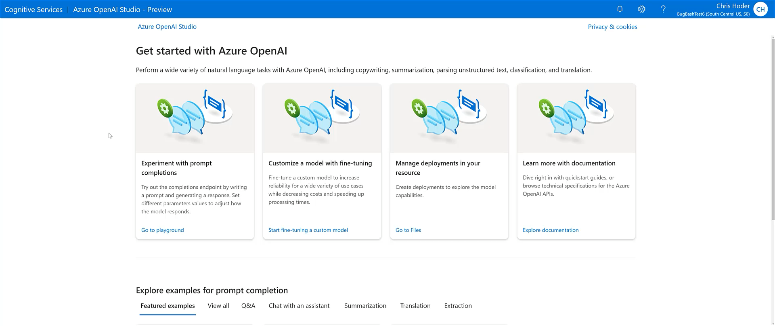
Azure OpenAI Playground demo Enabling all skill levels to build prototypes easily and explore the art of possible

Slide 70






Architecture design to build the PoC
PDF OCR pipeline
Azure functions
Web Application
Azure OpenAI Service Embeddings model
Documents
Azure Form Recognizer
Azure Cache for Redis (Enterprise)
Power BI
Azure OpenAI Service
Prompt: Passage QnA

Slide 71
Step-by-step process flow in the Jupyter Notebook
Extract text from documents
Chunk text and create embeddings
Store embeddings
Vector similarity search
Prompt engineer a passage based QnA solution
Step-by-step process flow
Use Form Recognizer to extract text from NLP papers
Chunk the text and create embeddings using Azure OpenAI embeddings model
Spin up Azure Cache for Redis (Enterprise) and store the embeddings
Leverage vector Similarity feature of Cache for Redis to get top n similar chunks
Take top n similar texts as a passage and prompt engineer into passage based QnA solution
GitHub Repo: <will clean code, add to the GitHub repo, provide the link here>

Slide 72
Considerations
Slides comprise of a business use case and demo implementation (PoC)
PoC implementation is not an enterprise grade
For this PoC, Azure Redis for Cache Enterprise version is used which is expensive
This PoC is devised for Enterprise Grade search and QnA scenarios
We can use any embeddings models based on the use case
Prompt engineering is the key (Prompt engineering samples provided in the deck)
Playing with the parameters like temperature can help customize the result based on the use case
Fine-tuning the models could also help

Slide 73


Document Clustering, and Cluster Theme Generation Summarize and extract document similarity embeddings, mine for similar clusters, generate cluster themes
Document Embeddings
Clustering (k-means)
Extract cluster themes: Summarize across documents in same cluster
Doc1 | [0.5622, 0.4530, 0.2848, …, 0.5325]
Doc2 | [0.0015, 0.9407, 0.2201, …, 0.1942]
Doc3 | [0.0033, 0.7006, 0.0576, …, 0.0517]
Cluster 1 Theme: Sports News Stories | Cluster 1 Theme: Sports News Stories
Doc summary: | “New York Yankees Win World Series in Dramatic Game 7 Finish”
Doc summary: | "Usain Bolt Sets New World Record in 100m Dash at Olympics"
Doc summary: | "Tiger Woods Claims Masters Title for the Sixth Time"
Azure OpenAI Service
Azure OpenAI Service
Document Summaries
Documents
Cluster 2 Theme: Finance News Stories | Cluster 1 Theme: Sports News Stories
Doc summary: | "Tech Giant XYZ's Stock Surges 20% Following Strong Earnings Report"
Doc summary: | "Fed Interest Rates Remain Unchanged Following Policy Meeting"
Doc summary: | "Oil Prices Plummet as Demand Weakens Due to COVID-19 Pandemic"
Doc1 | [ Text document summary ]
Doc2 | [ Text document summary ]
Doc3 | [ Text document summary ]
Azure OpenAI Service
Scikit-learn
Azure Machine Learning Workspace
Azure OpenAI Service

Slide 74
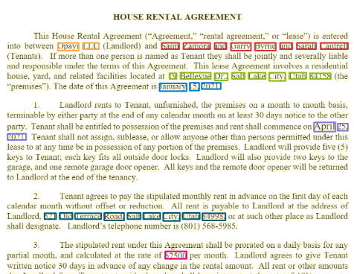
Lease processing with zero-shot learning approach
Send a single prompt to model
Azure OpenAI model extracts specific entities
…and returns in the format requested
The prompt consists of the:
Natural language instruction task, in this case, along with the text, or lease document
With no additional training, or label-dataset, the model extracts specific entities based on the natural language instruction and document context
Custom named entity recognition requires fine-tuning a large model, with your own, labeled data samples. Here, the model extracted the custom entities with 0 examples or fine-tuning!
Using the lease below return a json object containing the landlord, tenant, address of leased property, agreement date, start of the contract, etc..
This House Rental Agreement (“Agreement”, “rental agreement,” or “lease) is entered between Opay LLC (Landlord) and Sam Zamora and Garry Byrne and Sarah Cantrel (tenants). If more than one person is named as Tentant they shall be…..
{
"Lessor": "Bob Marshall",
"Lessee": "The United States of America",
"Property Address": "#205 Lifton Avenue, Ft. Overview Heights, St. James, Barbados",
"Property Description": "3 bedrooms, 2 bathrooms, living-dining room, family room, and kitchen",
"Net Size of Property": 1725,
"Net Size of Property Units": "square feet",
"Gross Size of Property": null,
"Gross Size of Property Units": null,
"Contract Start Date": "1997-05-23",
"Lease Start Date": "1997-06-28",
"Lease End Date": "2003-06-27",
"Lease Term": "6 years",
"Monthly Lease Amount": "BDS$5,300",
"Payment Frequency": "quarterly in advance",
"Payment Address": "11 Parma Avenue, Ft. Overview Heights, St. James, Barbados"
}
Notes:
The ability to extract targeted pieces of information from documents, specific to each customer and use case is a common, emerging use case across industries. This typically requires iteratively training a customized model, against a curated, customer dataset. Here we see the model’s ability to extract precise information from a document, from a simple instruction, in natural language - enabled by the Large Language Models's (LLM) capability to understand the context of the inquiry/instruction, and the context of the document.

Slide 75
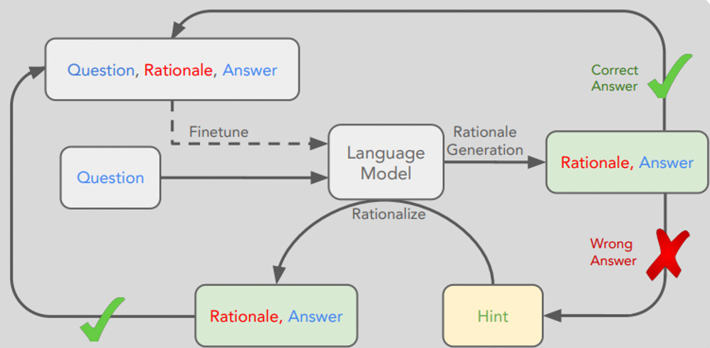
Fine-Tuning with Chain-of-Thought
Notes:
In general, to eke out maximum performance on a task, you’ll will probably have to eventually fine-tune a custom model. However, fine-tuning a model using explanations may take thousands of example explanations, which are costly to write and sometimes lead to the same output as the original base model.
By combining the benefits of fine-tuning with the benefits of chain-of-thought prompting you can generate synthetically thousands of example explanations that can then be used for fine-tuning, which will lead to even better results.
In this example we use the generative aspect of the model with few-shot prompts to generate a dataset of explanations that could be used to fine-tune a model
For example, if you have large quantities of unstructured text that you want to train on, you may find opportunities to use a prompt to extract a structured dataset from your unstructured text, and then fine-tune a custom model on that structured dataset.

Slide 76
How to adapt GPT-3 model for your task
No Gradient Updates
Zero-Shot
The model predicts the answer given only a natural language description of the task.
One-Shot
In addition to the task description, the model sees a single example of the task
Few-Shot
In addition to the task description, the model sees a few examples of the task.
Fine Tuning
The model is trained via repeated gradient updates using a large corpus of example tasks.
Prepare and upload training data
Train a new fined tuned model
Use your fine-tuned model
1.
Higher quality results than prompt design
2.
Ability to train on more examples than can fit in a prompt
3.
Token savings due to shorter prompts
4.
Lower latency requests

